Slide 1
Our Analysis
How Common Core Curriculum
Has Changed GT Mathematics
By Atholton Elementary Students:
Xan, Tori, Brendan & Jensen

Slide 2
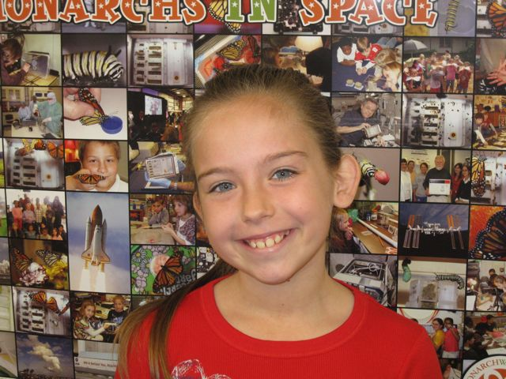
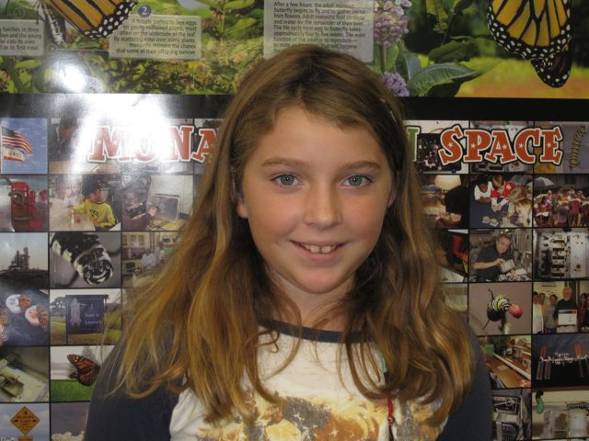
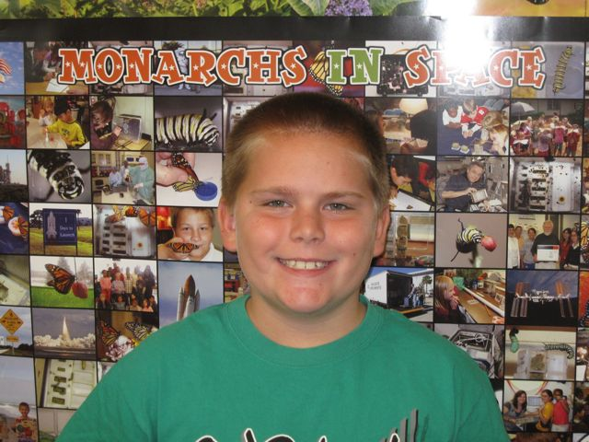
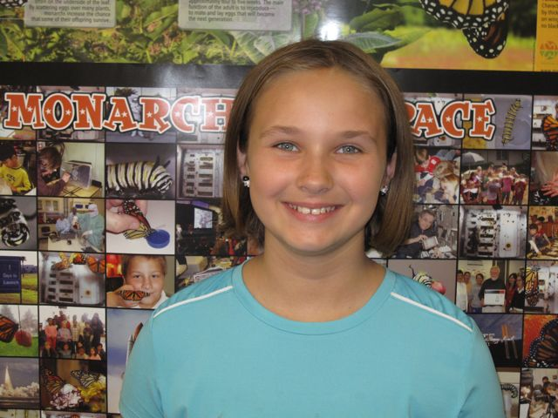
Xan
Tori
Brendan
Jensen

Slide 3
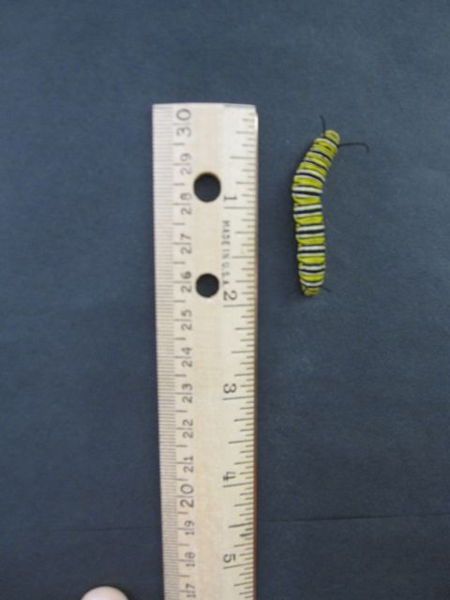
Monty is 2 inches long and ready to
form her chrysalis

Slide 4
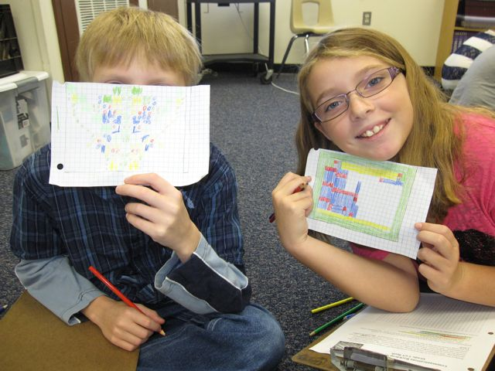
“Common Core makes math more fun.”

Slide 5
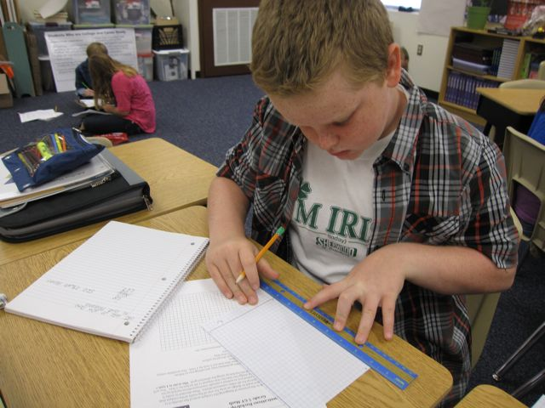
“Now we start with the big idea,
and we discover the math within it.”

Slide 6
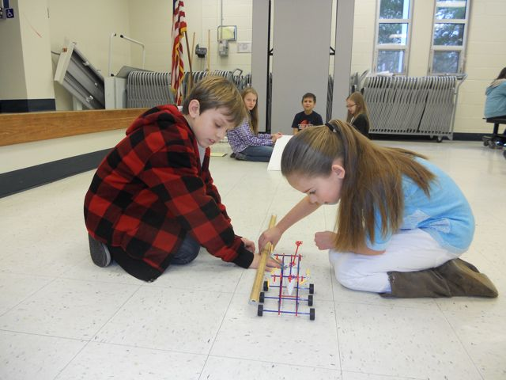
“…students work together and learn to be cooperative as well as independent. It’s more engaging, and we are learning helpful strategies for working through problems in the future.

Slide 7
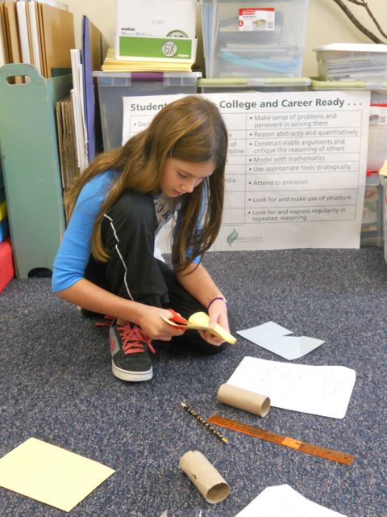
“…on a task, you are using your abilities and what you know and applying them to a certain situation, so you really have to know the math.”

Slide 9
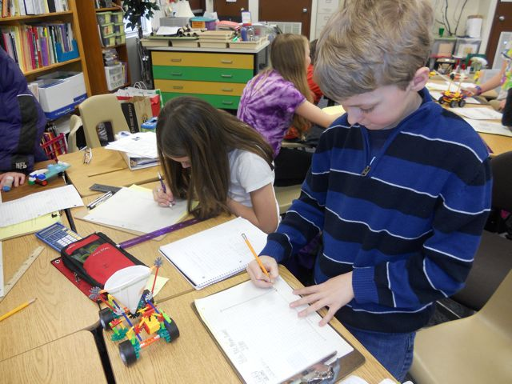
“One big task leads to multiple concepts – it all flows. We are now learning the application of knowledge…”

Slide 10
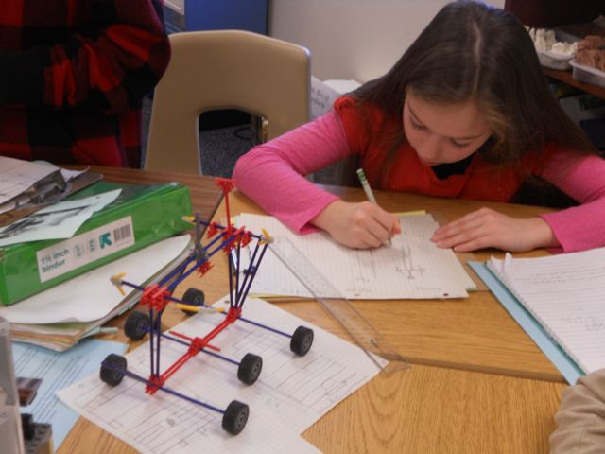
“…there are multiple answers that you can get by going about the problem using different strategies.”

Slide 11
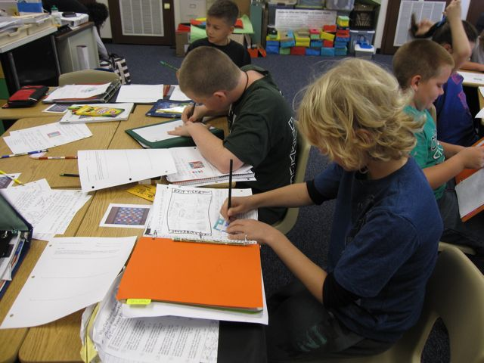
“Sometimes we make the problems, and we create them so they are challenging for our own level and intellect.”

Slide 12
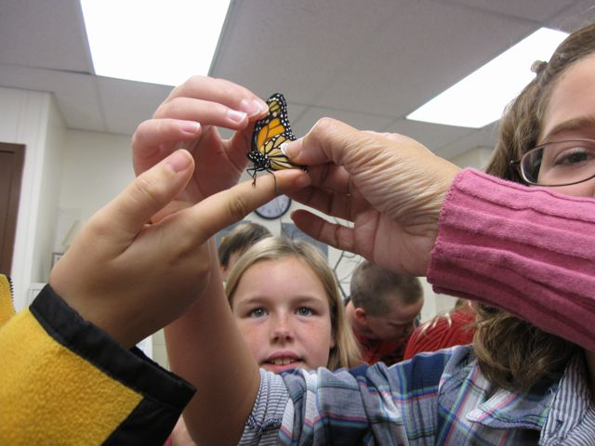
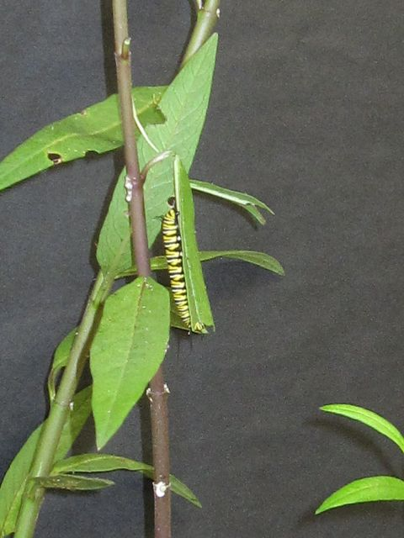
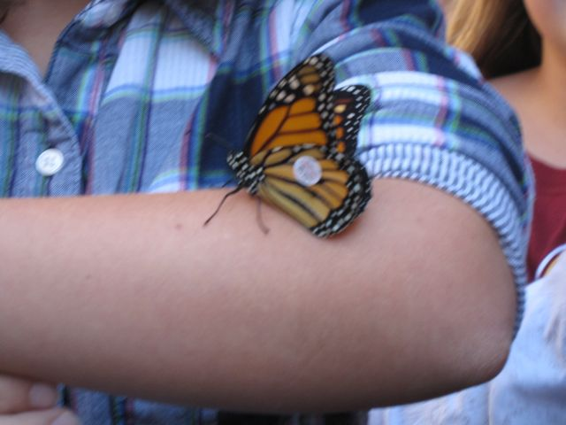

Slide 13
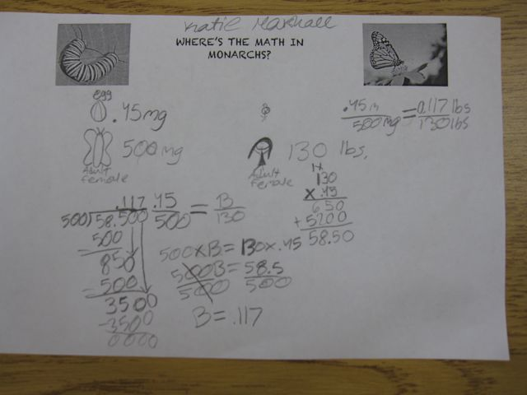
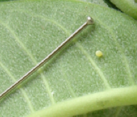
“We incorporated math into the process of raising
the butter-
flies.”

Slide 14
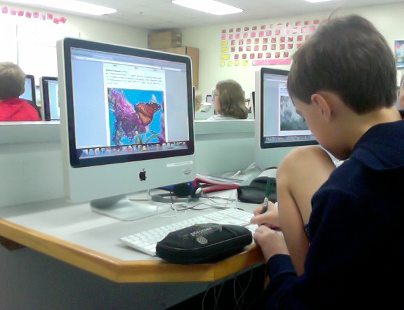
“We tracked the Monarchs’ pattern in flying after tagging and releasing our own Monarchs.”

Slide 15
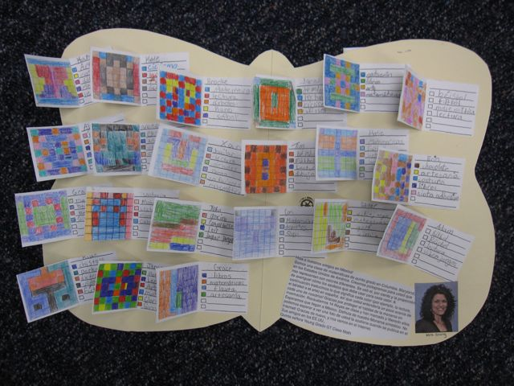
“We decided we would each create a glyph composed of activities we like to do.”

Slide 16
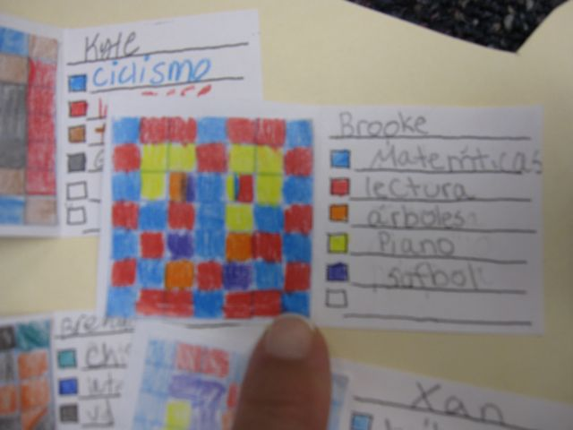
“We recorded the Spanish translations on the key, because we wanted the school children in Mexico to
learn about who we are.”

Slide 17
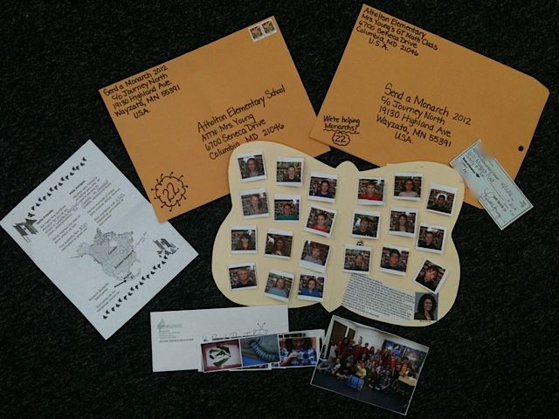
“…we wanted to help in some way.”

Slide 18
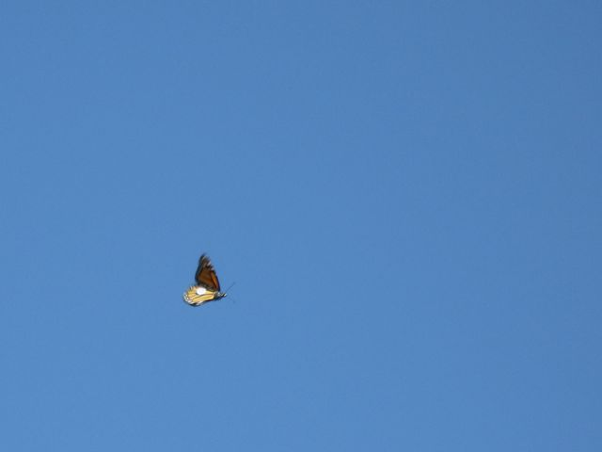
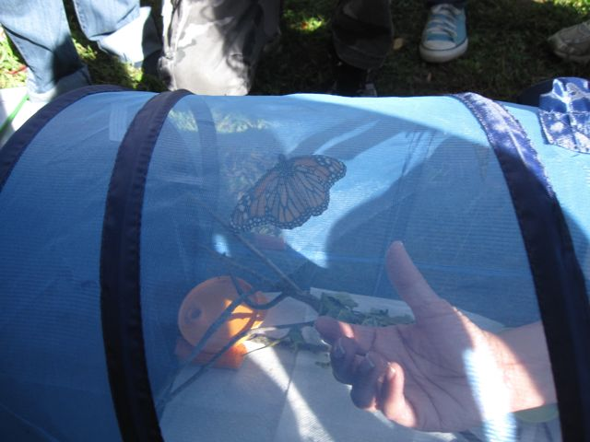
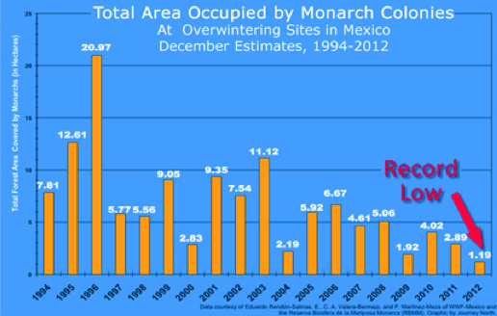

Slide 19
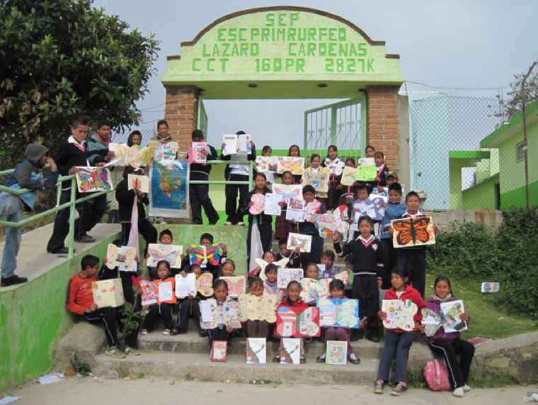
Our Symbolic
Monarch!

Slide 20
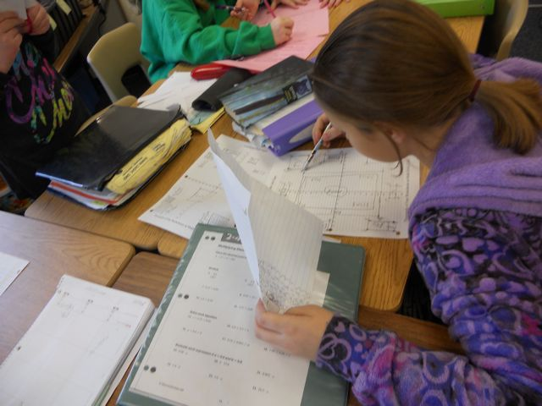
“…using integers on a coordinate plane to plan a bedroom layout…”

Slide 21
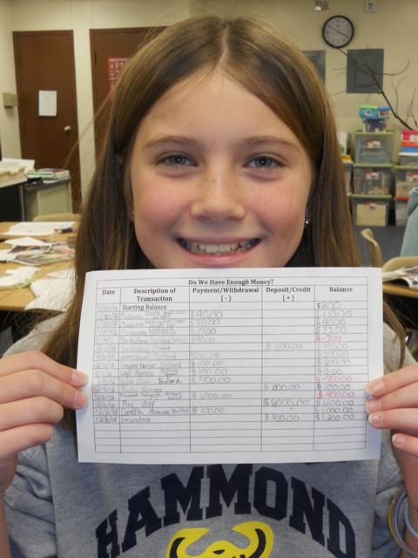
“…we used integers to keep track of expenses and earnings based on a budget…”

Slide 22
“…choosing our own items and keeping an accurate budget.”

Slide 23
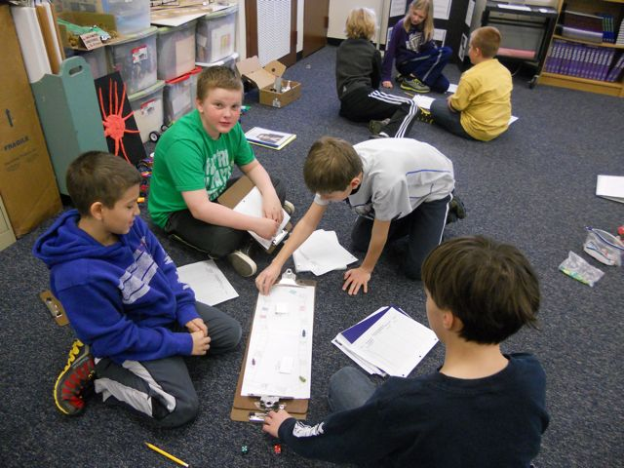
“We created our own board games based upon positive and negative numbers.”

Slide 24
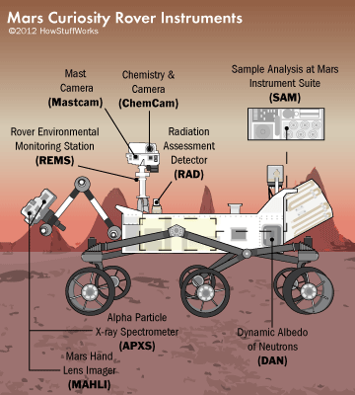
“We learned about something important in science and history and, once again, connected that with math skills and concepts.”

Slide 25
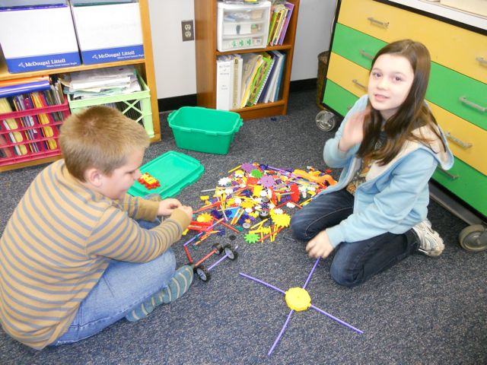
…we used some engineering skills to build our own miniature rovers using Legos and K’Nex.”

Slide 26
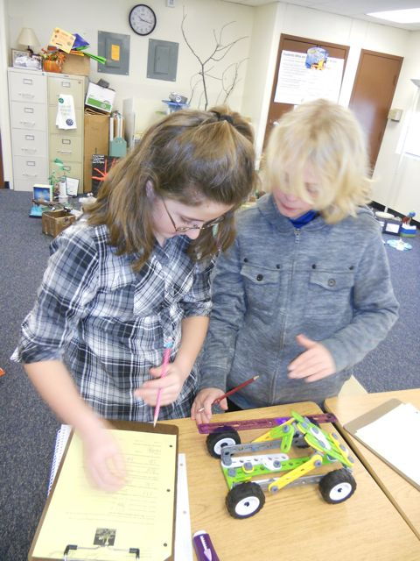
“We measured, we converted between decimals and fractions, and we computed using fractions and mixed numbers.”

Slide 27
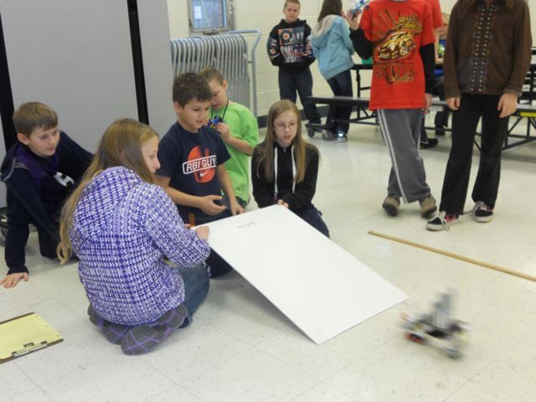
“We did this by measuring the distances our rovers traveled when rolled down a ramp.”

Slide 28
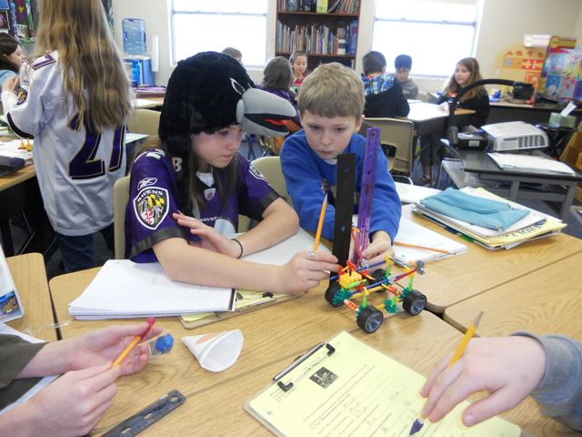
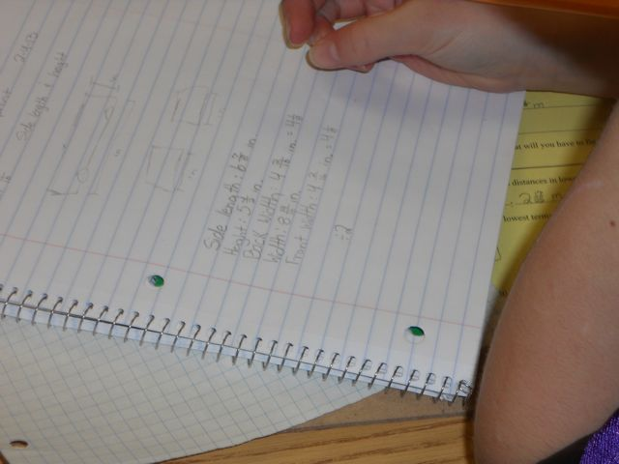
“We had to measure and convert to find dimensions to construct a rover crate.”

Slide 29
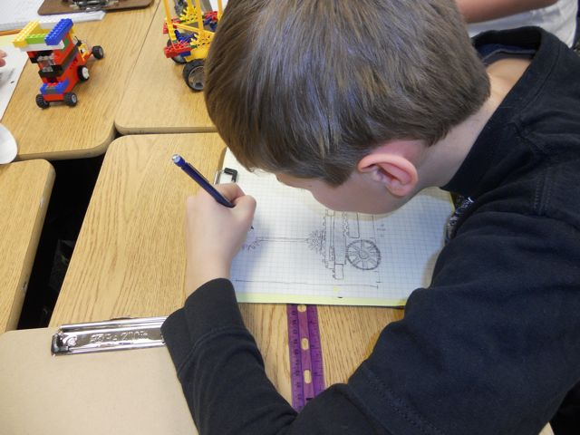
“We also made scale drawings for rover blueprints.”

Slide 30
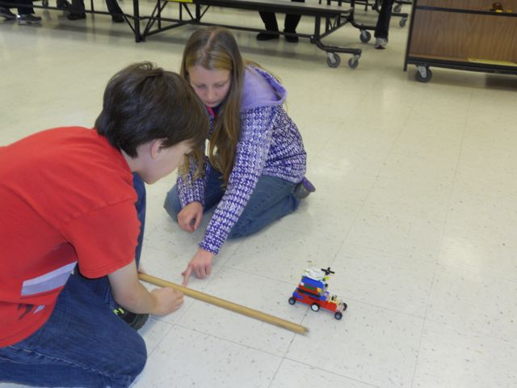
…hands-on way of learning math.”

Slide 31
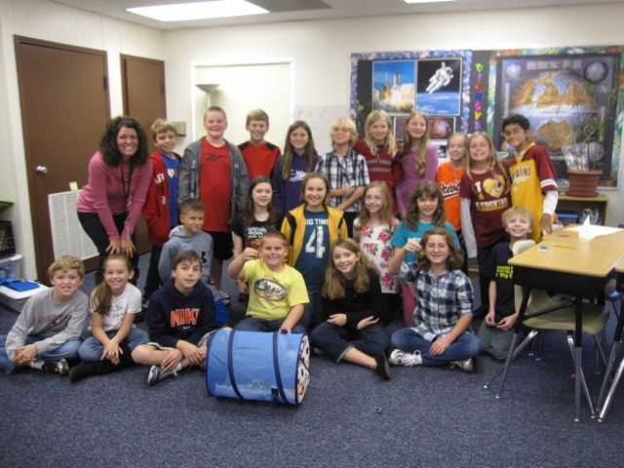

Slide 32
